Slide 1
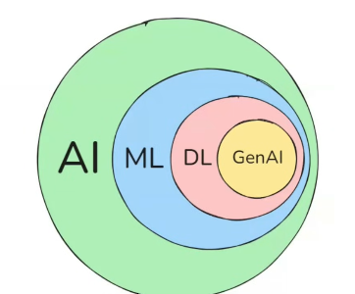

π
Neural Network
Neural network & History
Neural Network –How it works
Component of Neural network
Activation Function
Backward error propagation
Time Series Data
ANN,CNN,RNN
ANN
Neural Network-Layman term
RNN
Type of RNN
Problem with RNN
LSTM
Notes:
Content: https://www.linkedin.com/pulse/chunking-strategies-ai-data-kash-kashyap-0lghe/

Slide 2
1
2
3
Gradient Descent
Loss /Cost Function
Time Series
Relu
TanH
Vanishing Gradient Problem
Learning Rate
Sigmoid
feed forward NN

Slide 3
Perceptron
Weights
bias
perceptron is also an algorithm used for supervised machine learning. Just like linear regression ,logistic regression
Perceptron is not just an algorithm, you can also call it a mathematical model or function.
That's why, before learning deep learning, you must understand perceptron's very well
Algorithm
Supervised Learning
- Mathematics model
- function
1
b
∑
f
output
Ranges
-1 ,1
w2
z
x2
Z>=0 1
Z<0 0
w1
Activation function(step fn )
x1
Z=x1w1+ x2w3+b
First, let’s talk about the different parts.
So, first, you provide inputs to the perceptron from this side—these are x1 and x2. These are the actual inputs. Now, what is this 1? I’ll explain it in a bit. Then, these connections between the input and the block are called weights and bias.
For example, this w1w1 and w2w2 are both weights. I'm writing here: these are called weights. This connection through 1 is called bias, so I’ve represented it as b.The process is, things come together at summation point—the sum is computed, specifically via a dot product. We do 1x1×w1, x2×w2, and b×1b×1. So, in this part, this operation happens. Let’s call the output z. Then z moves to the activation function.
Notes:
Content: https://www.linkedin.com/pulse/chunking-strategies-ai-data-kash-kashyap-0lghe/

Slide 4
activation function brings z into a given range. This could be -1 to 1, 0 to 1, or something else. The purpose of the activation function is to restrict the value because weights, inputs, and bias can take any number. To bring it into range, we use a mathematical function, like a step function, if the value of z>=0, output is 1; if z<0, output is 0.
Let’s take a small problem—suppose we are solving a machine learning problem and we have data for some students. Assume we have data for 1,000 students. The data includes the IQ of each student, their college CGPA, and whether or not they got placed (placement as one or not).
IQ | CGPA | Placed
78 | 7.8 | 1
69 | 5.1 | 0
For example, for one student, the data could be: 78, 7.8, and the placement is done (1). For another, it could be 69, 5.1, and this student wasn't placed (0). So, let’s say our problem is to create a predictor, a model, such that when we give it this type of data, the model learns from it and in the future, when we provide a student's IQ and CGPA, it can predict whether the student will get placed or not.
So, in this perceptron model, we will do both:
First train it,
and then use it for prediction.
Let me explain how training works. For training, we take each student one by one and send them through this process.
Notes:
Content: https://www.linkedin.com/pulse/chunking-strategies-ai-data-kash-kashyap-0lghe/

Slide 5
For every student, x1 will be their IQ value and x2 will be their CGPA. For example, for the first student, you input 78 here and 7.8 here. Since we already know the correct output (placement), you can calculate the output. Depending on what the output is, you train this model accordingly
1
Training
Prediction
IQ | CGPA | Placed
78 | 7.8 | 1
69 | 5.1 | 0
b
∑
f
output
w2
z
7.8
X1- iq
X2- cgpa
w1
78
Basically, the idea is very simple—in this whole process, you need to calculate the values of w1, w2, and bb. The core objective of the whole training process is to figure out these weights and bias values.
Once you have calculated the weights and bias after training, you can do prediction. Here’s how: assume the weight values are something, let’s say w1 is n, w2 is t, and b is x—these are calculated during training. Now, suppose you get a new student whose CGPA is 5.1 and IQ is 100, and you want to use the perceptron to predict.
You would pass 100 as x1 (IQ) and 5.1 as x2 (CGPA). Then you sum them: 100×w1+5.1×w2+b. Let’s say b is 3 for now. You calculate z=100×w1+5.1×w2+3. This is your z.Now, you pass this zz through the activation function (like the step function). If z≥0z≥0, you say the student will be placed. If zz is negative, you say the student will not be placed.
So, this is how you make a prediction with a perceptron. But for that, you need to know your weights and bias, which in turn comes from the training process, for which you need data—just like with any other machine learning algorithm.
Notes:
Content: https://www.linkedin.com/pulse/chunking-strategies-ai-data-kash-kashyap-0lghe/

Slide 6
1000 records
1
IQ | CGPA | Placed
78 | 7.8 | 1
69 | 5.1 | 0
b
∑
f
output
w2
z
7.8
w1
78
you may also wonder: what if I have more than two input columns? For example, in addition to IQ and CGPA, what if I also have the student's state (Maharashtra, West Bengal, UP)? That too is an input.
So, what would your perceptron look like? It's simple: you provide as many x values as you have columns. If there's a third input, you'll have an x3 and a connection for it (with weight w3). Your summation now becomes
z=w1x1+w2x2+w3x3+b
Notes:
Content: https://www.linkedin.com/pulse/chunking-strategies-ai-data-kash-kashyap-0lghe/

Slide 7
We have data about students’ IQ and CGPA, as well as whether each student got placed or not. Now, suppose we train a perceptron model using this data, and let’s say we get specific values for the weights and the bias. Assume that the value of w1 (corresponding to IQ) is 2, the value of w2 (corresponding to CGPA) is 4, and the value of the bias is 1 for now.
1
b
∑
feature
f
output
importance
X2=cgpa
W2=4
z
W1=2
X2=iq
IQ | CGPA | Placed
78 | 7.8 | 1
69 | 5.1 | 0
Let me explain what these weights mean. These weights actually tell you about the strength of the connection between each input (e.g., IQ, CGPA) and your model. In other words, IQ feeds in through one connection and CGPA through another, and you can see which factor is more important when deciding whether a student gets placed.
In this example, CGPA is a more important factor than IQ for determining placement. Why? Because the weight for CGPA is greater than the weight for IQ—in fact, it’s twice as large. So, you can say that CGPA is a significantly more important feature than IQ for predicting whether a student will get placed according to this model.
That’s what the weights tell you: which input is more important and which is less important. So, you can draw the interpretation that weights represent feature importance in the perceptron model.
Notes:
Content: https://www.linkedin.com/pulse/chunking-strategies-ai-data-kash-kashyap-0lghe/

Slide 8
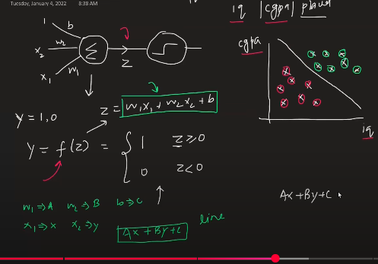
The perceptron, as we just saw, is a very simple model. It basically has two steps: summation and the step function operation. Let’s draw this more clearly:
First, there's the summation
Then, there's the activation function (step function)
These are our inputs: w1, w2, bias, x1, x2
Suppose we have a dataset with IQ, CGPA, and placement result for a thousand students. If we look at this visually, the perceptron is basically a function whose output is either 1 or 0 because it uses a step function.
So, you can write y as a function of z, where
y=f(z)
z=w1x1+w2x2+b
Now, the output will be 1 if z≥0z≥0,
and the output will be 0 if z<0z<0.
So, y is a function of z, and this z is calculated using the above logic.
Notes:
Content: https://www.linkedin.com/pulse/chunking-strategies-ai-data-kash-kashyap-0lghe/

Slide 9
Suppose we plot our dataset:
X-axis: IQ
Y-axis: CGPA
With 1000 students, you’ll have 1000 points.
Green circles: students who got placed (placement = 1)
Red circles: students who did not get placed (placement = 0)
You’ll see, those students with high IQ and high CGPA fall into the green cluster Those with low IQ and low CGPA fall into the red cluster
Our end goal is to make a predictor — a model that, when given a new student's IQ and CGPA, predicts whether the student will get placed or not.
Now, focus on this — have you seen this equation before?
If you replace the symbols for weights and biases, all you get is the equation of a line in two dimensions:
Notes:
Content: https://www.linkedin.com/pulse/chunking-strategies-ai-data-kash-kashyap-0lghe/

Slide 10
a⋅x+b⋅y+c=0
So, your perceptron is nothing but a line. This line divides the space into two regions:
One side: placement will happen
Other side: placement will NOT happen
Therefore, by this logic, if the equation is true, placement happens; otherwise, it doesn’t. So, in a way, the perceptron divides the entire data into two regions and classifies new points accordingly. That’s why a perceptron is called a binary classifier, because it creates two regions (two classes).
Now, what if you have more than two inputs? For example, IQ, CGPA, and 12th standard marks: The equation becomes:
w1x1+w2x2+w3x3+b=0
Notes:
Content: https://www.linkedin.com/pulse/chunking-strategies-ai-data-kash-kashyap-0lghe/

Slide 11
In 3D, this equation represents a plane that still divides your data into two regions. You can imagine the plane as a sheet dividing the room; points above the sheet are one class, below are another.
In 2D: perceptron = line
In 3D: perceptron = plane
In higher dimensions: perceptron = hyperplane
But the principle is always the same: the perceptron divides your data into two parts.
The perceptron is a linear classifier that divides the data into two regions using a line, plane, or hyper plane depending on the number of features.
It can only perfectly classify data that can be separated linearly.
https://www.desmos.com/calculator
Notes:
Content: https://www.linkedin.com/pulse/chunking-strategies-ai-data-kash-kashyap-0lghe/

Slide 12
Function of ML- frequently used
Notes:
Content: https://www.linkedin.com/pulse/chunking-strategies-ai-data-kash-kashyap-0lghe/

Slide 13
Components of Neural Network
​Neural Network has something important that is called Neuron
What is it?
This is basic building block of Human brain that is responsible for communicating what is Happening through out the body
N1
N2
There has to Be Communication between these 2 Neuron so that we get our Intelligence and We Get What we Have to . What is JOB of Artificial NN The JOB is to mimic Human Brain behavior .to Achieve this We create Artificial Neuron Network
Let’s take an ice cube and place it on the skin. What happens? We feel cold. But before we feel cold, some reception is happened— that’s called input. And then Some Neurons in our mind, which tell us ,we are feeling cold at this place.
Function or Something is happening in hidden that is called hidden layer. once we get feeling of cold .we call it output
similar to this ,in Artificial Neural network there are different layer.
In between i​/p and o​/p ​ there are diff hidden layers, responsible for processing
Notes:
Content: https://www.linkedin.com/pulse/chunking-strategies-ai-data-kash-kashyap-0lghe/

Slide 14
Let’s understand this with Employee attrition training data
Employee Attrition Training Data
Age | Salary | Tenure | Attrition
24 | 80 | 1 | Y
26 | 100 | 3 | Y
25 | 90 | 2 | N
30 | 120 | 5 | N
32 | 150 | 8 | Y
i/p
h
o/p
Age
Salary
Tenure
As our common business understanding we know that ​Age, Salary, and tenure is not equally responsible for someone to take decision to stay or leave the organization.
i want ​to give more weight to Salary. these input get multiply with weight and will go to the neuron
Age
0.6
0.8
Salary
0.4
Tenure
Notes:
Content: https://www.linkedin.com/pulse/chunking-strategies-ai-data-kash-kashyap-0lghe/

Slide 15
0.6
∑wixi=(24*.06+80*0.8+1*.04)+0.1
Employee Attrition Training Data
24
Age
0.8
Age | Salary | Tenure | Attrition
24 | 80 | 1 | Y
26 | 100 | 3 | Y
25 | 90 | 2 | N
30 | 120 | 5 | N
32 | 150 | 8 | Y
80
Salary
0.4
1
Tenure
b=0.1
Y=mx + c
If C=0 ,The line passes through the origin. But this does happen most time in real world then we put c here to make line more flexible
Similarly we also added a initial bias to make model more flexible
So what is happening in this neuron(in hidden layer) we are feeling cold.in this neuron ,there is concept of activation function
We have assign some weight in begining,but we do not know wether those weight are good for network or not.
so we have to come back and optimize those weight .we have to come back and optimize bias. We have to also see the activation function which is used is doing the good job or not . otherwise we need to change as well
if information flow in forward direction, we called it forward propagation.
when we come back and optimize the paramater,we called backward propagation.
Notes:
Content: https://www.linkedin.com/pulse/chunking-strategies-ai-data-kash-kashyap-0lghe/

Slide 16
To understand “Backward Propagation". We require good underling of few math concept like as
Gradient
What is it
❓
Chain rule of differentiation
How Gradient descent works
Notes:
Content: https://www.linkedin.com/pulse/chunking-strategies-ai-data-kash-kashyap-0lghe/

Slide 17
Activation Function
​it is the rule that tells a neuron when to fire or when not
A Node, that is nothing but a replica of neuron, when it receives multiple input signals depending on the nature of input signal we combine them and pass in a function that we called activation fn.
Depending upon the input intensity it is defined the output.
Linear Function
Hevi side function
V
If V>>a
F(v)=a+v
a=bias
v=∑WiXi
F(v)=
Weight Sum
0
Otherwise
a is here threshold
it have only two state or give two output
X axis
1
Y axis
1
X axis
Y axis
Notes:
Content: https://www.linkedin.com/pulse/chunking-strategies-ai-data-kash-kashyap-0lghe/

Slide 18
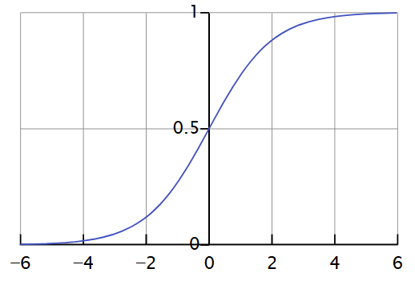
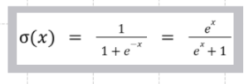
Sigmoid Activation Function
Disadvantage
𝜎(𝑥)=1/(1+𝑒−𝑥)
Vanishing
Gradient
problem
Output range: Always between 0 and 1, regardless of the input.
Shape: It has an S-shaped curve (called a sigmoid curve), which smoothly transitions from 0 to 1.
It is Non Zero Centered Function
Notes:
Content: https://www.linkedin.com/pulse/chunking-strategies-ai-data-kash-kashyap-0lghe/

Slide 19
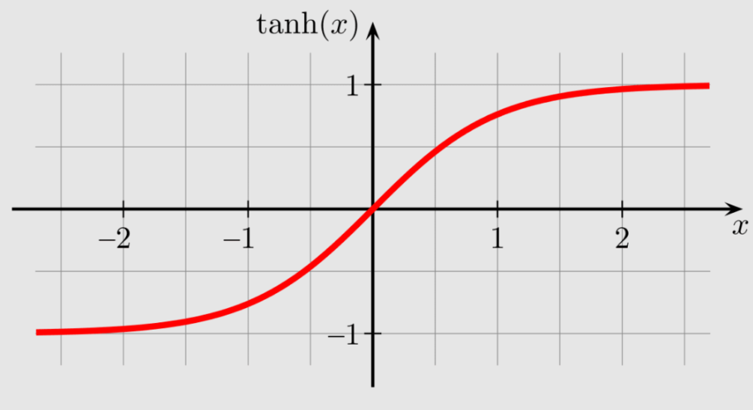
TanH Function
TanH Activation function is superior then the Sigmoid Activation function because the range of this activation function is higher than the sigmoid activation function. This is the major difference between the Sigmoid and TanH activation function. Rest functionality is the same as the sigmoid function like both can be used on the feed-forward network.
Limitation
Vanishing
Gradient
problem
Output range: its range in between [-1,1].
S-shaped curve similar to the sigmoid function, but its zero-centered output makes it more effective for hidden layers
Notes:
Content: https://www.linkedin.com/pulse/chunking-strategies-ai-data-kash-kashyap-0lghe/

Slide 20
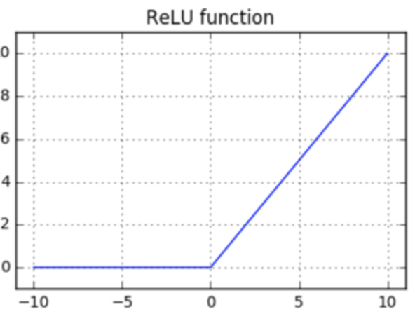
ReLu (Rectified Linear Unit) Activation Function
ReLu is the best and most advanced activation function right now compared to the sigmoid and TanH because all the drawbacks like Vanishing Gradient Problem is completely resolved in this activation function which makes this activation function more advanced compare to other activation function.
Range: 0 to infinity
Equation can be created by:
{
Xi if x >=0
0 if x <=0
}
+Side : linear in Nature
-Side : Output Zero
Notes:
Content: https://www.linkedin.com/pulse/chunking-strategies-ai-data-kash-kashyap-0lghe/

Slide 21
Activation Function

Slide 27
π
Neural network
It(ANN) is a foundation of all neural net.
ANN – Artificial Neural Network
Deep
Learning
Cnn – Convolution neural net.
RNN – Recurrent Neural network
It is also called feed forward neural net.
It is mainly used for simple task like-
Email Spam Checker
Struggles with : Complex Task Jus like
Images
Sequential Task
Notes:
Content: https://www.linkedin.com/pulse/chunking-strategies-ai-data-kash-kashyap-0lghe/

Slide 28
π
CNN
Convolution neural Network
We used it when we are dealing with images or any shape
RNN
Recurrent Neural Network
Whenever we are dealing with data that comes with sequence
Like ,
Time Series
Text
Speech
LSTM(Long Short Term memory)
LSTM is a type of RNN
- Short Term Memory Loss
- Long Memory (High Computation )
Notes:
Content: https://www.linkedin.com/pulse/chunking-strategies-ai-data-kash-kashyap-0lghe/

Slide 29
π
Artificial Neural Network
Notes:
Content: https://www.linkedin.com/pulse/chunking-strategies-ai-data-kash-kashyap-0lghe/

Slide 30
RNN-Recurrent Neural Network
Recurrent=occurs again and again=happen repeatedly
ANN –Feed forward neural network
Y
this is a Machine Learning AI Model Where output loop back in system as a input
H
Takeaway Point
X
There is no memory
Only focuses or remember "current input" state(consider only current i/p state)
Data flows in only one direction(i\p- o\p)
There is no memory in ANN
as a resultant create a problem
that's why ANN can not handle sequential data
they can not handle sequential Data
Notes:
Content: https://www.linkedin.com/pulse/chunking-strategies-ai-data-kash-kashyap-0lghe/

Slide 31
ANN
Feed
Forward
Neural
Network
There is no cycle or feedback loop
information is flow only one direction input to output
to Overcome ANN Drawback by providing memory
1
By Which it can store past input state
2
It is also consider previous input state along with current state
Y
input
H
output
Output as a input for next step
X
Notes:
Content: https://www.linkedin.com/pulse/chunking-strategies-ai-data-kash-kashyap-0lghe/

Slide 32
Lets understand RNN with a example:
Imagine reading a sentence and you try to predict the next word, you don’t rely only on the current word but also remember the words that came before. RNNs work similarly by “remembering” past information and passing the output from one step as input to the next i.e. it considers all the earlier words to choose the most likely next word. This memory of previous steps helps the network understand context and make better predictions.
I was born in Germany. I can speak .....
Y
input
H
output
X
neural network used to look like this but how it suddenly started looking like this also with loop
Notes:
Content: https://www.linkedin.com/pulse/chunking-strategies-ai-data-kash-kashyap-0lghe/

Slide 33
I was born in Germany. Hence I can speak .....
you should fill this blank with German
how are you able to say that because you are able to relate from the previous information okay so if I give you just one information for example if I give you just speak word maybe you will not be able to fill this but since I am
giving you everything right from starting to end you are able to derive that meaning and you are able to fill this that is how human mind works but unfortunately computers do not work like this until or unless you know
a specialized Network it built in such a way so that is where RNN comes into picture
so what RNN does is if anybody asks you how RNN is different from basic neural networks so there is only one word that differentiates RNN from the normal neural network and that is memory
W1 W2 W3 W4 W5 W6--- ………………… Wn Wn+1
I was born in Germany. Hence I can speak .....
Simplicity I will write here word one over 2 word 3 and you can go up to here let's say word n okay so when I am at word n plus 1 then I remember I remember what happened at word 2 and what happened at word 3 and what happened at word four that that is the only thing that makes RNN different from normal basic artificial neural network
if you do not remember the context then you may not be able to derive this word with the meaningful derivation

Slide 34
in my corpus i have 2 document
4 unique word in my corpus
d1 => Sky is blue
d2=> Sky is black
d1
1 | 2 | 3
Sky | Is | blue
d2
 |  | 4
Sky | Is | black
Timestamp
Sky | Is | blue
t-1 | t | t+1
how the training will happen this entire thing d1 will be treated as one record right so when the first record goes into the network all these three words will not go together so first Sky will go let's call this time t-1.then is will go let's call this time t and then blue will go let's call this time t+1.
In the training of one single record we are sending three words at three different time intervals and this concept in the world of RNN is called time stamp
when we say memory in RNN that means at time t+1 ,two things has already happened what are those two things one is Sky and one is “is” so RNN will remember what happened at time t and what happened at time t-1
Notes:
Content: https://www.linkedin.com/pulse/chunking-strategies-ai-data-kash-kashyap-0lghe/

Slide 35
Y
o/p
HL
input
H
output
i/p
X
Notes:
Content: https://www.linkedin.com/pulse/chunking-strategies-ai-data-kash-kashyap-0lghe/

Slide 36
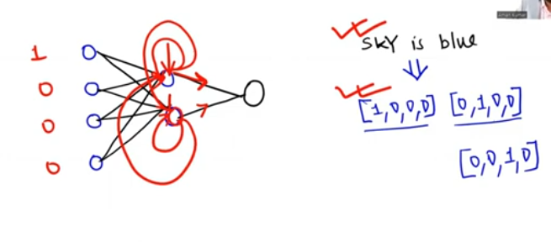
OHE
Notes:
Content: https://www.linkedin.com/pulse/chunking-strategies-ai-data-kash-kashyap-0lghe/

Slide 37
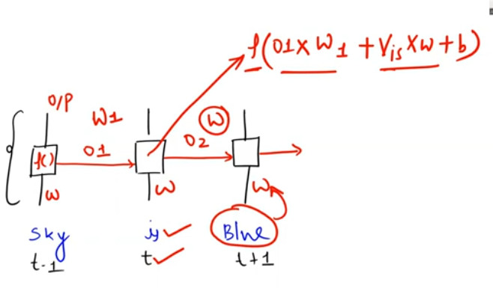
Notes:
Content: https://www.linkedin.com/pulse/chunking-strategies-ai-data-kash-kashyap-0lghe/

Slide 38
Types of RNN
One to One RNN
Image
Image Classification
suppose my input is a image and my problem is image classification so for one input how many outputs I will just get one output
Notes:
Content: https://www.linkedin.com/pulse/chunking-strategies-ai-data-kash-kashyap-0lghe/

Slide 39
One to Many
Which means our input will be one but output can be many
i/p -> image
o/p -> Bus,Truck,Cycle,Traffic light
if I give my input as an image so my output can be multiple things that are present in that image for example there can be a bus present ,there can be a truck present ,there can be a let's say bicycle or cycle present there can be a traffic light ,so from one input image ,I am getting multiple outputs in this kind of architecture
Notes:
Content: https://www.linkedin.com/pulse/chunking-strategies-ai-data-kash-kashyap-0lghe/

Slide 40
Many to One
which means in the input we can pass multiple input but outputs is only one
i/p -> sentence
o/p -> sentiment
"Movies was not good" => "Negative"
if I give my input as an image so my output can be multiple things that are present in that image for example there can be a bus present ,there can be a truck present ,there can be a let's say bicycle or cycle present there can be a traffic light ,so from one input image ,I am getting multiple outputs in this kind of architecture
Notes:
Content: https://www.linkedin.com/pulse/chunking-strategies-ai-data-kash-kashyap-0lghe/

Slide 41
Many to Many
which means in the input we can pass multiple input and we also receive multiple outputs
i/p -> sentence
o/p -> sentence
Sentence Translator – English to Hindi translator
if I give my input as an image so my output can be multiple things that are present in that image for example there can be a bus present ,there can be a truck present ,there can be a let's say bicycle or cycle present there can be a traffic light ,so from one input image ,I am getting multiple outputs in this kind of architecture
Notes:
Content: https://www.linkedin.com/pulse/chunking-strategies-ai-data-kash-kashyap-0lghe/

Slide 42
Problem of RNN / what is difficulty to work with RNN
Leftover
https://www.youtube.com/watch?v=6ig4Mpbi0a8&t=37s
Notes:
Content: https://www.linkedin.com/pulse/chunking-strategies-ai-data-kash-kashyap-0lghe/

Slide 43
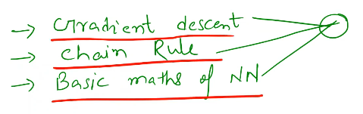
Need to learn
Notes:
Content: https://www.linkedin.com/pulse/chunking-strategies-ai-data-kash-kashyap-0lghe/

Slide 44
Notes:
Content: https://www.linkedin.com/pulse/chunking-strategies-ai-data-kash-kashyap-0lghe/

Slide 45
Important Term
It is the mathematic way of measuring “how wrong a model” prediction are compared to actual value
Loss Function
Learning Rate
Network adjust the weight to reduce the loss is called gradient descent
Notes:
Content: https://www.linkedin.com/pulse/chunking-strategies-ai-data-kash-kashyap-0lghe/

Slide 46
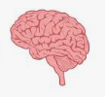
how brain Works
How does your brain work? Whenever you read something, it first goes into your short-term memory. This type of memory usually fades away by the next day. That means, whatever you read, about 80% to 90% of it will be forgotten by the next day. Only around 10% remains. Why? Because all that information was stored in your short-term memory. But if you read the same thing two or three times, the process of short-term memory transfers directly into long-term memory. In other words, all that information now becomes part of your long-term memory
Notes:
Content: https://www.linkedin.com/pulse/chunking-strategies-ai-data-kash-kashyap-0lghe/

Slide 47
LSTM
let's read this sentence together
Aman stays in London. Aman has a friend whose name is Alex .Alex is a data scientist .Aman learns data science from .........
So based on our human intelligence we can simply say the right word for this place is Alex. because Aman has a friend who is Alex and Alex knows data science so Aman must be learning data science from Alex
but you know something interesting here you used two things together one is called long term memory and other is called short-term memory what is a long term memory.
long term memory is "Aman and Alex Friends" and
"Alex knows data science" is something short-term memory.
When you combine these two things together then you come to the right answer "Alex can teach data science to Aman" and when long term memory and short-term memory combines together we get something known as long short term memory
Notes:
Content: https://www.linkedin.com/pulse/chunking-strategies-ai-data-kash-kashyap-0lghe/

Slide 48
4
h1
h2
h3
as we know in the world of simple RNN,
these sentences will go one by one into the network then I will get some output
My
name
is
Aman
Vanishing Gradient Problem
in this network there is a very basic problem that is Vanishing gradient problem .
the vanishing gradient problem occurs when the network tries to remember information from many previous time steps — especially in long sequences (e.g., 100 words). As it reaches the final time step, the model struggles to retain and differentiate between important and unimportant information from earlier steps.
so some of these words may be important for my sentence some of these words may not be important for my sentence but my network is not able to understand that that is problem number one and
problem number two is I am not able to understand what will optimize my model because of this Vanishing gradient problem when you are trying to optimize your weight .we are not able to capture which word is more meaningful which word is less meaningful which word you should focus more which word you should focus less and since there is a gradient problem so if the network is long then network will not perform efficiently so our previous words will start losing importance
So Hence LSTM came into picture
Notes:
Content: https://www.linkedin.com/pulse/chunking-strategies-ai-data-kash-kashyap-0lghe/

Slide 49
in
simple RNN the problem is ,
we don't know which part of the sentence is important because of this the previous words in a long sentence starts losing its importance
Aman stays in London. Aman has a friend whose name is Alex. Alex is a DS. Aman learns DS from ......
irrelevant
Long Term Memory
Short Term Memory
Forget gate
i/p gate
o/p gate
relevant
relevant
Long term memory means all the words in your sentence imagine there is a conveyor belt in which all the words are flowing like that that is your long term memory
----→ ----→ ----→ ----→ ----→ ----→ ----→ ----→ ----→ ----→ ----→ ----→ ----→
short term memory I want to predict .
so what I highlighted in red here in blue color written in blue color is my short term memory
Notes:
Content: https://www.linkedin.com/pulse/chunking-strategies-ai-data-kash-kashyap-0lghe/

Slide 50
Ct-1
Ct
Long term Memory
Ht-1
Ht
Short term Memory
forget
input
o/p
Notes:
Content: https://www.linkedin.com/pulse/chunking-strategies-ai-data-kash-kashyap-0lghe/

Slide 51
Notes:
Content: https://www.linkedin.com/pulse/chunking-strategies-ai-data-kash-kashyap-0lghe/

Slide 52
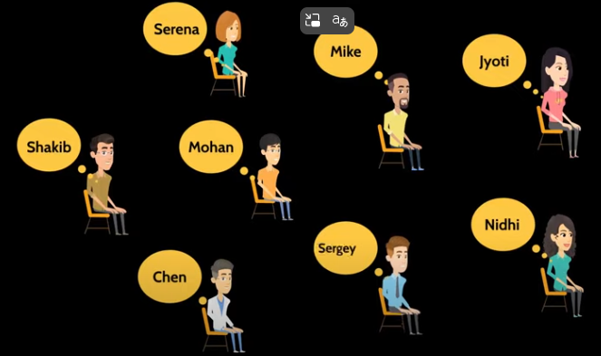
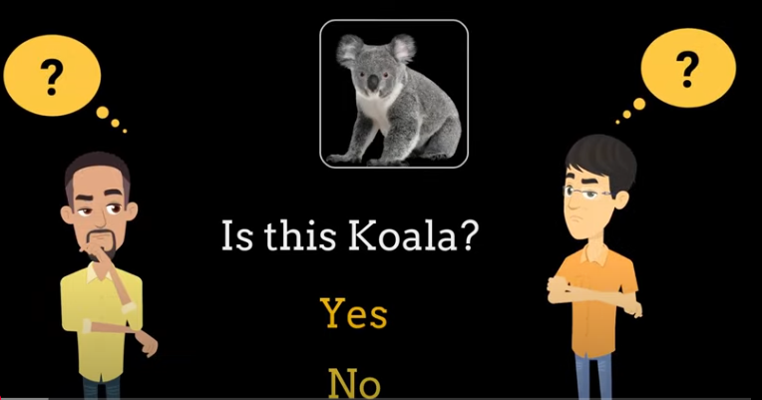
π
NEURAL NETWORK
Suppose there is a group of students who have never seen
koala in the life koala is a nice cute looking animal from Australia and these students are very naive and they have never seen this animal
our job is to train this group of student
so that you give them an image and they will be able to tell you whether this image has koala or not you can make this a teamwork and give individual responsibility to each
Notes:
Content: https://www.linkedin.com/pulse/chunking-strategies-ai-data-kash-kashyap-0lghe/

Slide 53
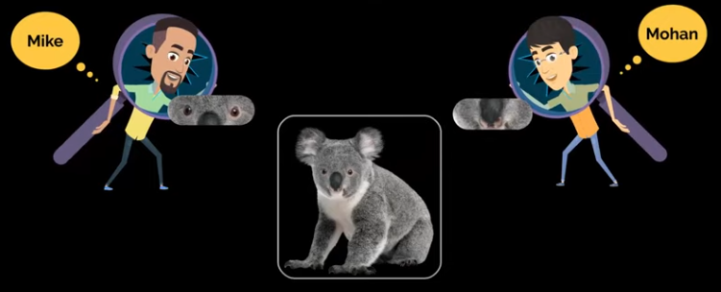
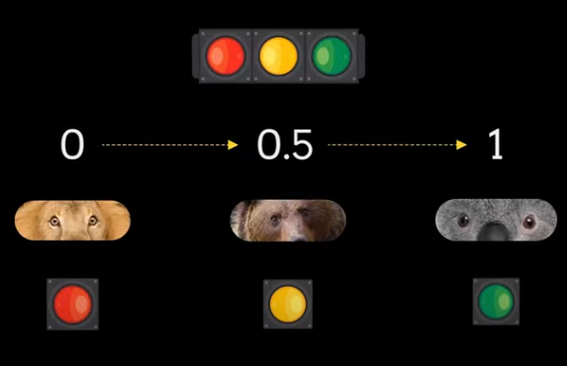
π
these students such as mike can work on detecting only eyes
Mohan can work on detecting only nose
so each of these students are working on detecting a specific
part of koala's body
from an image they give their decision is by using a score of 0 to 1
where 0 means this is definitely not
koala's eyes 0.5 means yeah it looks like koala's eyes
I'm not sure maybe 50 50 1 means it is definitely koala's eyes
so mike has become now expert koala eye detector
similarly Mohan is an expert koala nose detector when you give them an
image of lion mike will say the decision is point zero three because
the eyes they are like round eyeballs but they don't look like koala's eyes so 0.03 similarly for nose he can just give some score and if the score is more than 0.5 we'll say yeah those are koala's eyes
Notes:
Content: https://www.linkedin.com/pulse/chunking-strategies-ai-data-kash-kashyap-0lghe/

Slide 54
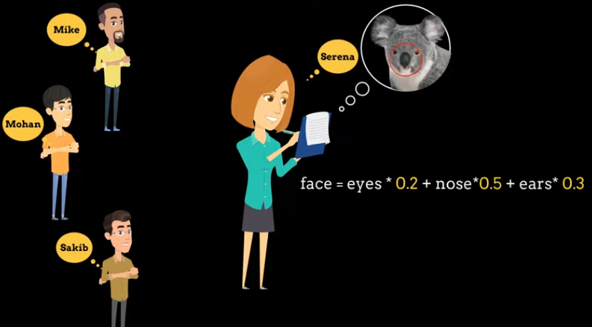
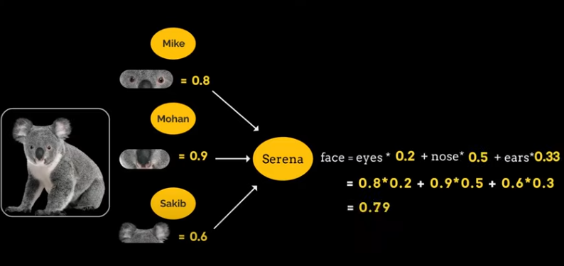
π
you can extend this collaboration further and make shakib an ear detection expert
and then these three students can go to Serena and Serena can work on deciding if the image has koala's face or not
so once Mike Mohan and Sakib says that this image has koalas eyes nose and ears, Serena can use their work to figure out if the image has koala's face or not and she can use a formula like this because
if you look at koala the nose in koala is very prominent koala's nose are very are different than other animals
so if there is a prominent feature then you can give that more weightage
and Serena can derive this formula for detecting the face and based on the scores that mike Mohan and Sakib gives
she will simply use this formula and tell you whether the image has koala's face or not for example in this particular case i have given sample a scores by each individual person and Serena computes the face score to be 0.79
so if anything is more than 0.5 it means it is koala's face
Notes:
Content: https://www.linkedin.com/pulse/chunking-strategies-ai-data-kash-kashyap-0lghe/

Slide 55
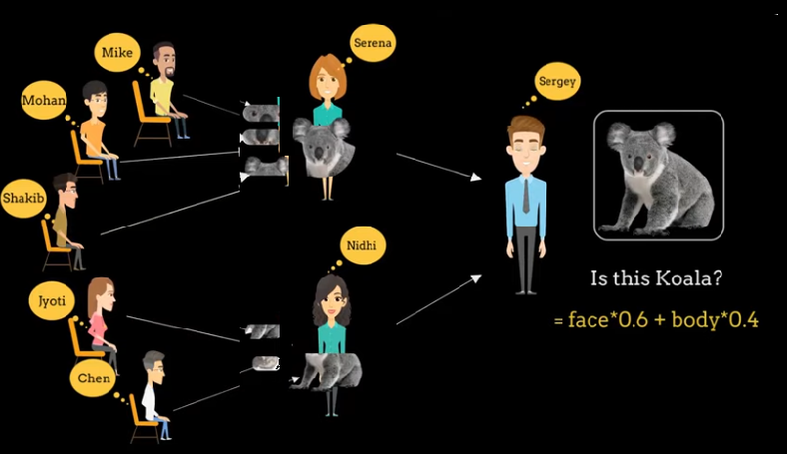
π
you can now use rest of the group where they individually for example Jyoti can detect legs and Chen can detect tail and they can tell their decision to Nidhi whose job is to say whether uh the image has koala's body or not and finally Serena and Nidhi will go to Sergey who will give the full final answer and he will also use some kind of formula here i am giving more weightage to face
because when we are working on face detection either humans or animals you know when we are working on
detecting whether it has humans or which animal we give more weightage to face
so now this group is doing this awesome teamwork and telling you whether the given image is koala's image or not
Notes:
Content: https://www.linkedin.com/pulse/chunking-strategies-ai-data-kash-kashyap-0lghe/

Slide 56
π
this is nothing but a neural network
each individual person here are individual neurons and they are working on a specific subtask and they pass the result of their subtask to the next group so Serena and Nidhi are actually in terms of neural network they are a
hidden layer Mike Mohan etc they're forming the input or the first layer and
Sergey is the output or the last layer so this is a neural network it's a trained neural network
Notes:
Content: https://www.linkedin.com/pulse/chunking-strategies-ai-data-kash-kashyap-0lghe/

Slide 57
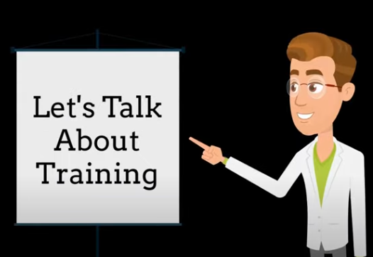
π
backward error propagation
Notes:
Content: https://www.linkedin.com/pulse/chunking-strategies-ai-data-kash-kashyap-0lghe/

